Slide 1

Improving Gnod Music Recommender
-Eulalia ORTIZ
- Fatma ZAAROUR
IronHack

Slide 2
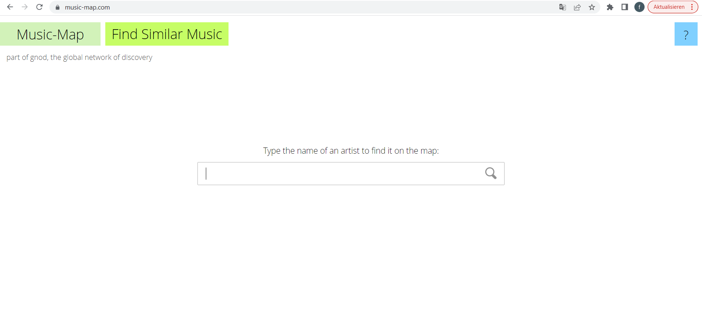
GNOD Discover New Music
AUSGABE
Introduce a new option in GNOD web page
- Search engine by song in addition to by band
Do you want me to recommend you a song ?

Slide 3


GNOD Discover New Music
AUSGABE
How can we do that?
Dataset: currently popular songs (100 hot songs billboard) and all time favourites (around 2000 songs).
Clustered by their musical features.
We used a KMean method to build models with different number of clusters.
Best performing model (lowest silhouette)), 16 clusters.

Slide 4

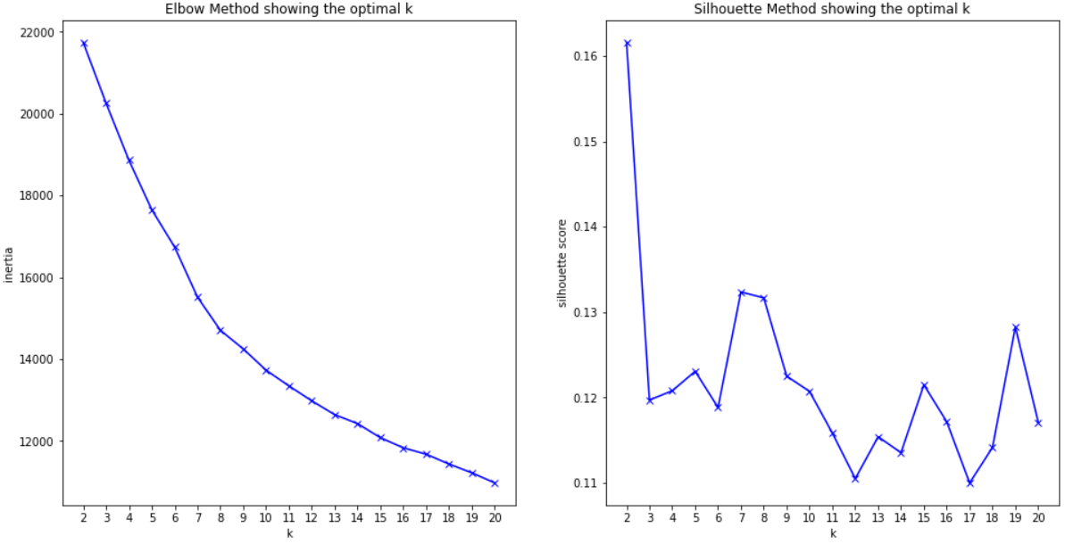
GNOD Discover New Music
K-means

Slide 5
GNOD Discover New Music
AUSGABE
How does it work?
Once the user inputs the title of a song, we offer him the option to select this title among five versions from Spotify, in order to refine his preferences.
The model assigns the song to one of the clusters and then recommends a song to the user from the same cluster, with a preference for a song that is currently popular.
Recommender still in its design phase

Slide 6
GNOD Discover New Music
Looking for songs?
How does our recommender behave so far :
when the user inputs a song that is currently popular, he usually gets a recommendation of a popular son.
when he inputs a song that is not so new or currently popular, he gets a recommendation of an old time favorite.
The recommender does not work well with classical music, very specialized segment, we have to enrich our database with information.
It works with teens and middle age population!!!!

Slide 7

GNOD Discover New Music
Next Steps
Use other methods to cluster the songs, test if they work better
Enrich the database with new songs
Test the recommender in the webpage and see how it behaves :
What segment of population it attracks, if we increase the traffic in the page and the engagement time.

Slide 8

GNOD Discover New Music
Thank you for your attention
Questions ??

